Slide 1

Encouraging Noticing:
Can visual supporting material contribute to effective teaching of technical skills?

Slide 2
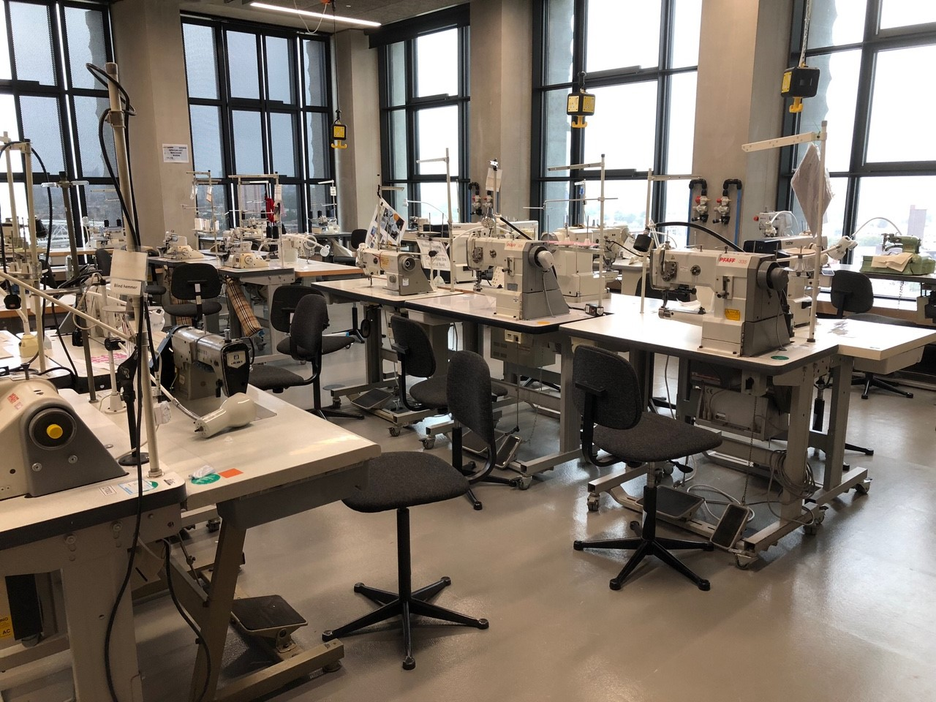
The Studio

Slide 3
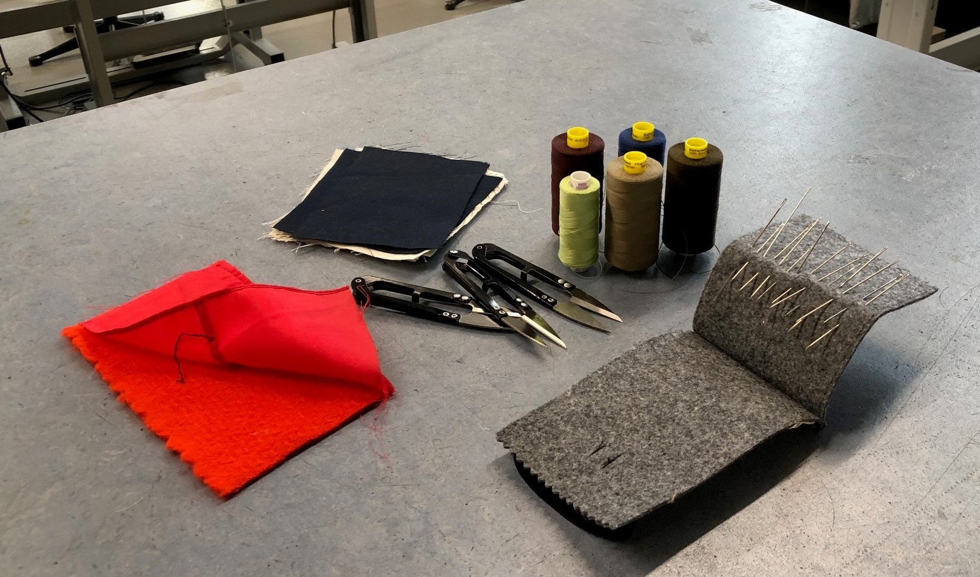
The Workshop

Slide 4
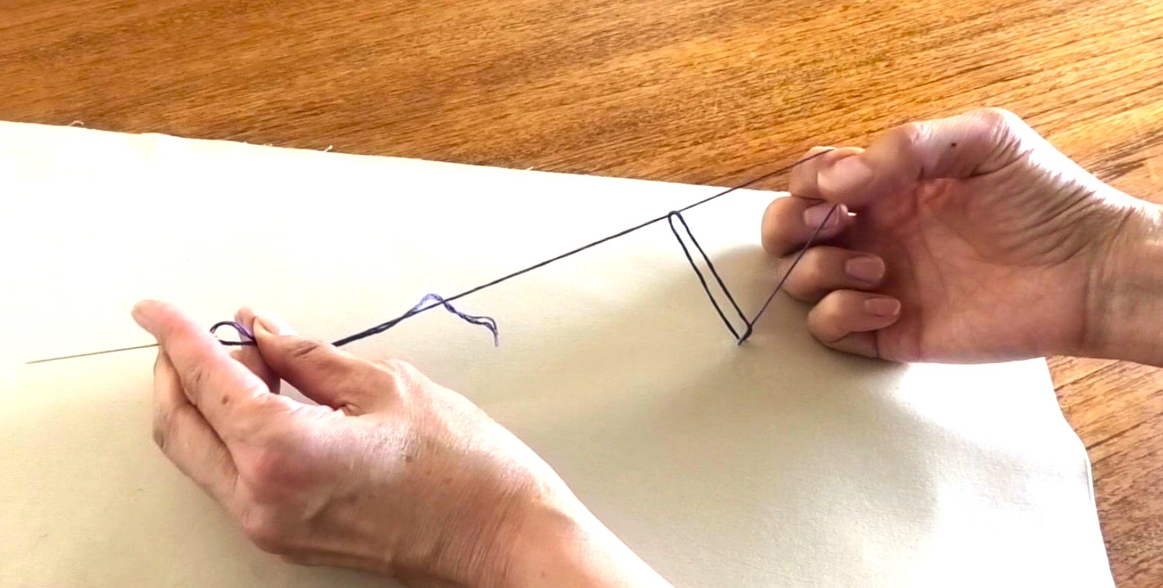
Sewing a Chain Stitch

Slide 5
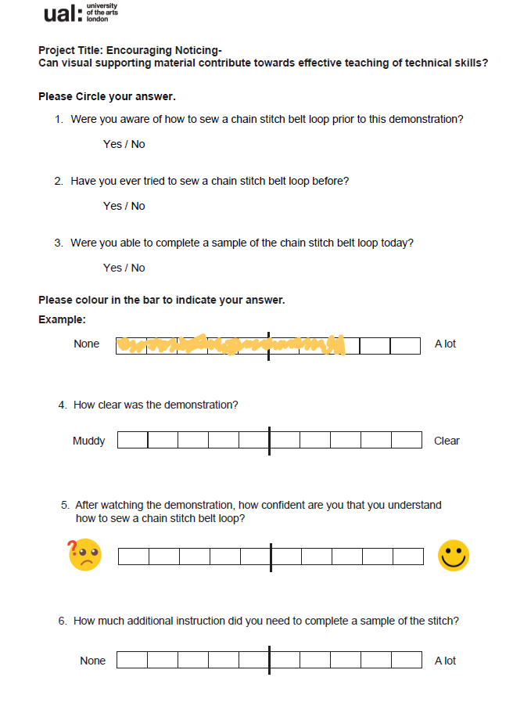
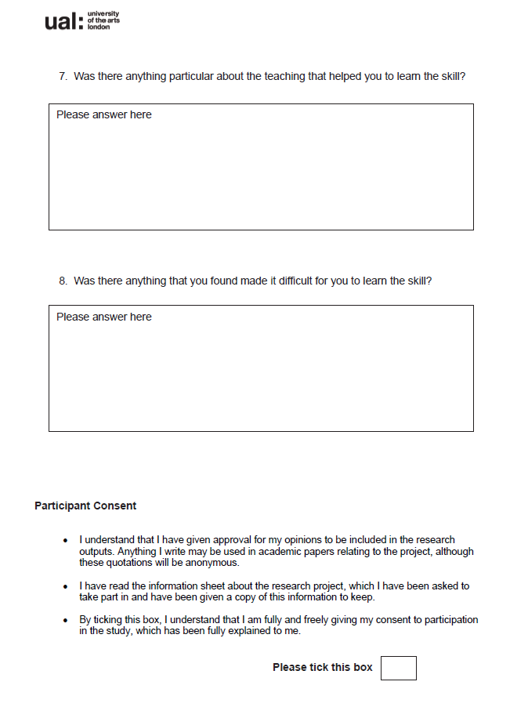
The Questionnaire

Slide 7
Q6 | ﻿ | Control | Video | PDF
Mean | ﻿ | 5.15 | 5.04 | 4.72
Standard Deviation | ﻿ | 2.76 | 2.51 | 2.13

Slide 8
“Video then in person increased confidence. Speaking and visuals helped focus.”
Participant Response

Slide 9
As I repeat the demonstration, I am varying the way I explain the process, incorporating adjustments in response to my observations of areas that students are finding problematic. I am drawing attention to where to apply the tension on the thread. . . and how to vary the size of the loop to make it more manageable. Could the iterative development of my own skill as a teacher be affecting the responses?’
Field Observation Note- 30th October 2023

Slide 10
‘As you, the educator-researcher, interacts with participants, you may find it necessary to continue the research with additional data sources to better address the question at the center of your research. When educators are researchers and a participant in their study, it is especially important to keep an open mind to the wide range of research methodologies.’
Spencer Clarke et al. (2020) Action Research. Available at:
https://kstatelibraries.pressbooks.pub/gradactionresearch/ (Accessed: 7 Jan 2024).

Slide 11
Bibliography
Allery, L. (2020) How to Teach Practical Skills. Cardiff: Centre for Medical Education.
Andrade, C. (2020) ‘Mean difference, standardized mean difference (SMD) and their use in meta-analysis: as simple as it gets’, Journal of Clinical Psychiatry, 81(5), article number 20f13681. Available at: https://doi.org/10.4088/JCP.20f13681
Bhagat, D. and O’Neill, P. (2011) Inclusive practices, inclusive pedagogies: learning from widening participation research in art and design higher education. Croydon: CHEAD.
Billett, S. (2010) Learning Through Practice: Models, Traditions, Orientations and Approaches. Dordrecht: Springer.
Bogner, K., & Landrock, U. (2016) Response Biases in Standardised Surveys.GESIS Survey Guidelines. Mannheim: GESIS – Leibniz Institute for the Social Sciences. Available at: https://doi: 10.15465/gesis-sg_en_016
Coffield, F. et al. (2004) Learning styles and pedagogy in post-16 learning: A systematic and critical review. London: Learning and Skills Research Centre.
Curry, L. (1990) ‘A critique of the research on learning styles’, Educational Leadership. 48(2), pp.50–56.
Dunn, R. (1984) ‘Learning Style: State of the science’, Theory Into Practice, 23(1), pp.10-19.
Finnegan, T. and Richards, A. (2016) Retention and attainment in the disciplines: Art and Design. York: Higher Education Academy.
Francis, J.J. et al. (2010) ‘What is an adequate sample size? Operationalising data saturation for theory-based interview studies’, Psychology and Health, 25(10), pp. 1229-1245.
Freeman, C. and Kobia, C. (2016) ‘Sewing for a Cause: Implementing and Evaluating Service-Learning in a Clothing Construction Course’, Journal of Public Scholarship in Higher Education, 6, pp.45-59.
Giacomino, K. et al. (2020) ‘The effectiveness of the Peyton’s 4-step teaching approach on skill acquisition of procedures in health professions education: A systematic review and meta analysis with integrated meta-regression, PeerJ, 8(10129), pp.1-26. Available at: http://doi.org/10.7717/peerj.10129
Gray, C. & Malins, j. (2004) Visualising Research: A guide to the research process in Art and Design. Aldershot: Ashgate Publishing Ltd.
Gurung, R. & Prieto, L. (2009), Getting culture: incorporating diversity across the curriculum. New York: Routledge.
Harris, A. (2021) A Sensory Education. Abingdon and New York: Routledge.
Hughes, C. & Cohen, R. L. (2010) ‘Feminists really do count: the complexity of feminist methodologies’, International Journal of Social Research Methodology, 13(3), pp.189-196.
Kara, H (2022) Embodied Data Analysis. Available at: https://www.youtube.com/watch?v=k79AWH59JpQ/ (Accessed: 7 January 2024)
Kolb, D.A. (1984) Experiential learning: experience as the source of learning and development. New Jersey: Prentice Hall Inc.

Slide 12
Bibliography continued
Lahti, H. (2012) ‘Learning sewing techniques through an inquiry’, Procedia Social and Behavioural Sciences, 45, pp.178-188.
Madriaga, M. et al. (2010) ‘Confronting similar challenges? Disabled and non‐disabled students’ learning and assessment experiences’, Studies in Higher Education, 35(6), pp.647-658.
Mayer, A. (2021) ‘Reducing respondents’ perceptions of bias in survey research’, Methodological Innovations, 14(3). Available at: https://journals.sagepub.com/doi/10.1177/20597991211055952
McNiff, J. (2002) Action Research for Professional Development. Jean McNiff.
Morse, J.M. et al. (2002), ‘Verification Strategies for Establishing Reliability and Validity in Qualitative Research’, International Journal of Qualitative Methods, 1(2), pp.13-22.
Moussa, N. (2014) ‘The Importance of Learning Styles in Education’, Institute for Learning Styles Journal, 1(Fall), pp. 19-27.
Niiranen, S. (2019) ‘Supporting the development of students’ technological understanding in craft and technology education via the learning-by-doing approach’, International Journal of Technology and Design Education, 31, pp.81–93.
Noga, H. (2014) ‘Applying Chosen Teaching Methods in Technical Education’, International Journal of Engineering Pedagogy, 4(4), pp.23-26.
Reynolds, M. (1997) ‘Learning Styles: A Critique’, Management Learning, 28(2), pp.115-133.
Rohrer, D. & Pashler, H. (2012) ‘Learning styles: Where’s the evidence?’, Medical Education, 46, pp.634-635.
Romero, P. et al. (2018) ‘Halsted’s “See One, Do One, and Teach One” versus Peyton’s Four-Step Approach: A randomized trial for training of Laparoscopic Suturing and Knot Tying’, Journal of Surgical Education, 75(2), pp.510-515.
Royal Society of Chemistry (2024) Practically Perfect. Available at: https://edu.rsc.org/ideas/how-to-help-students-develop-their-practical-skills/4016986.article. (Accessed: 11 January 2024)
Shildrick, M. (2012) Critical Disability Studies: rethinking the conventions for the age of postmodernity. London: Routledge.
Slocum, A. & Beard, C. (2005) ‘Development of a CAI Module and Comparison of its Effectiveness with Traditional Classroom Instruction’, Clothing and Textiles Research Journal, 23(4), pp.298-306.
Spencer Clarke et al. (2020) Action Research. Available at: https://kstatelibraries.pressbooks.pub/gradactionresearch/ (Accessed: 7 January 2024).
Wang, T. et al. (2004) ‘An Education Theory–Based Method to Teach a Procedural Skill’, Archives of Dermatological Research, 140(11), pp.1357-1361.
Willis, S. (2017) ‘Literature review on the use of VAK learning strategies’, The STeP Journal, 4(2), pp. 90-94.
Wood, N. et al. (2009) ‘A Tacit Understanding: The Designer’s Role in Capturing and Passing on the Skilled Knowledge of Master Craftsmen’, International Journal of Design, 3(3), pp.65-78.

Slide 13
'the purpose of demonstration and these set-ups is to guide the students in the art of noticing, to help them to learn how to see.'
Harris, A. (2021) A Sensory Education. Abingdon and New York: Routledge.

Slide 14
'Educators should instead focus on developing the most effective and coherent ways to present particular bodies of content, which often involve combining different forms of instruction, such as diagrams and words, in mutually reinforcing ways.’
Rohrer, D. & Pashler, H. (2012) ‘Learning styles: Where’s the evidence?’,
Medical Education, 46, pp.634-635.

Slide 15
Participant’s Learning Background and Learning Outcome:
Identifying the level of technical knowledge prior to the intervention and learning outcome after the intervention.

