Slide 1
Encouraging Noticing:
Can visual supporting material contribute to effective teaching of technical skills?

Slide 2
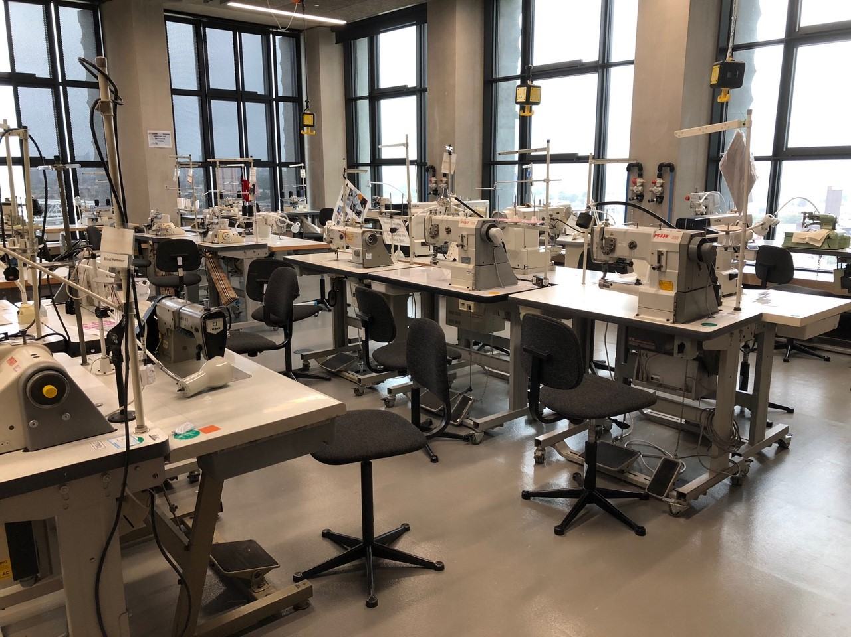
The Studio
My Background as a Technician at LCF.
identifying a problem- effective pedagogy for teaching technical skills.

Slide 3
ARP- Critical Disability theory- what helps all, helps one. The importance of non-verbal demonstration resonates with key ideas from inclusive teaching practices; introducing information in advance and in accessible formats.
'Educators should instead focus on developing the most effective and coherent ways to present particular bodies of content, which often involve combining different forms of instruction, such as diagrams and words, in mutually reinforcing ways.' Rohrer, D., & Pashler, H. (2012)
Multi- discipline research- teaching surgery in medical schools

Slide 4
'the purpose of demonstration and these set-ups is to guide the students in the art of noticing, to help them to learn how to see.'
(Harris, 2020)

Slide 5
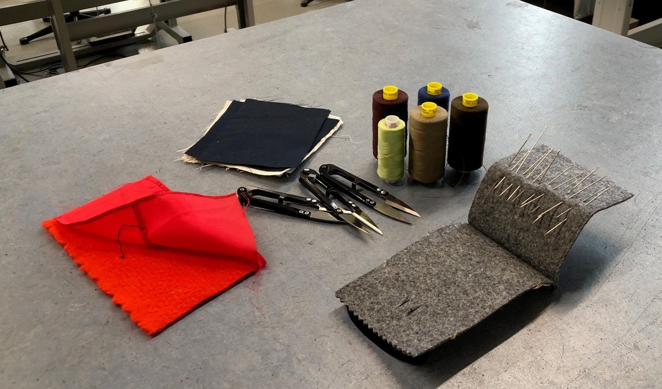
The Workshop
Methodology: Micro-teach workshop and Questionnaire.

Slide 6
Methodology- There is not a lot of quantitative research on teaching technical skills for garment construction. Micro-teach intervention and surveying using Questionnaires and observation as data collection tools. Previous AR cycles included observation and informal interviews to develop this workshop approach. Self-selecting group as I would ask for voluntary participants. Intervention is designed to be short to minimise disruption to participants' day. Teaching a skill that looks complicated but is easy once mastered. The value of learning a new skill is utilised to persuade people to participate. Time scale was looked at closely to fit around my teaching schedule.
Can't compare the same students' learning using different teaching methods as once they have been taught a skill, they cannot unlearn it and try it again with another method. So have to rely of large response rate. Quantitative surveying with qualitative questions to look more in depth into the subject.
Also, needed to keep the micro-teach very simple as I would have to teach, while still observing and administering multiple aspects of data gathering.
Questionnaire was designed to be short to maximise response rate.
Mainly closed ended and a few open ended questions to simplify the format for students with differing reading and writing abilities.
Students' available time is very limited.

Slide 7
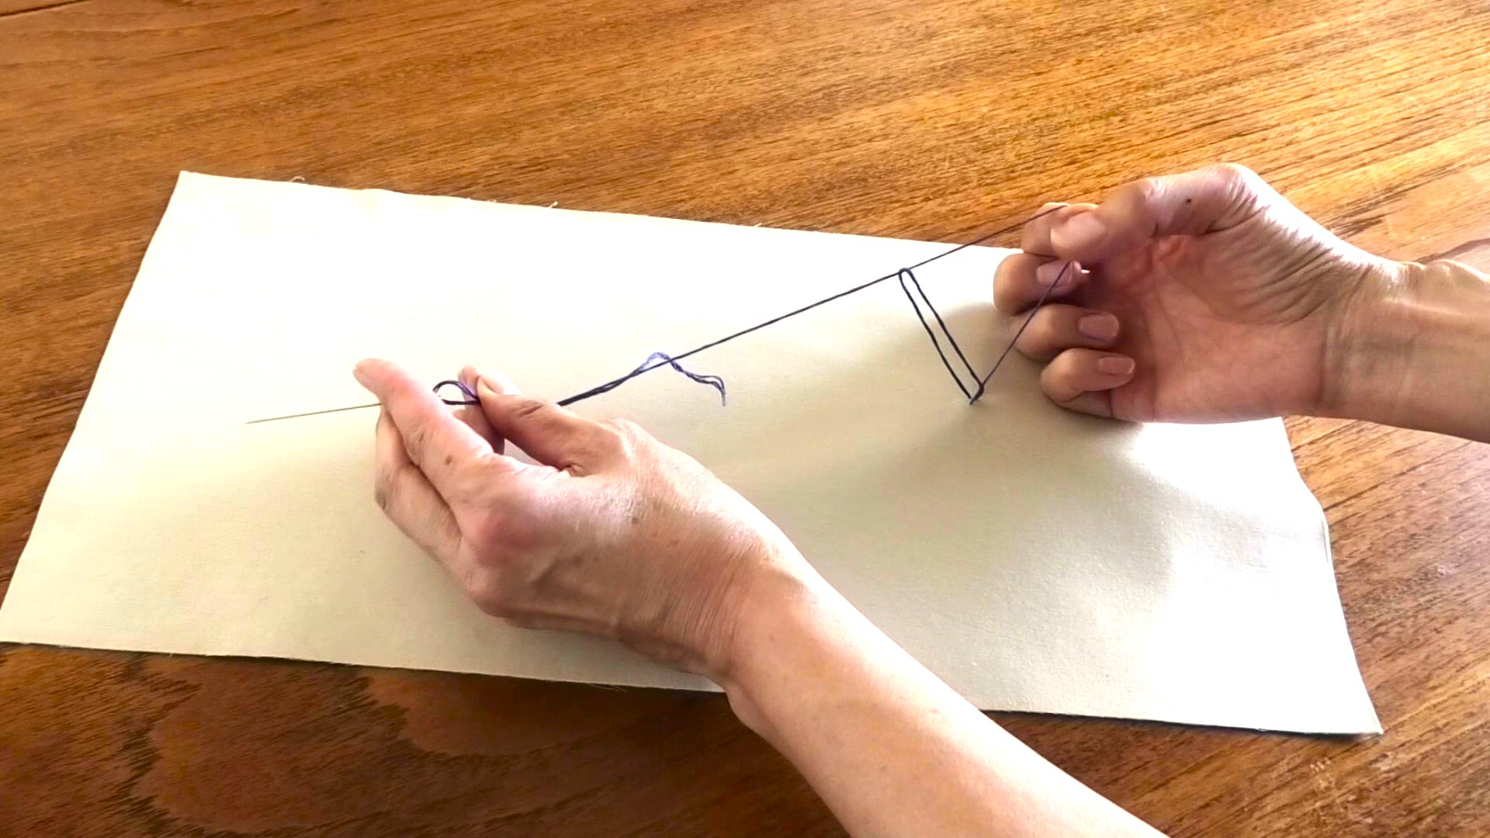
Sewing a Chain Stitch

Slide 8
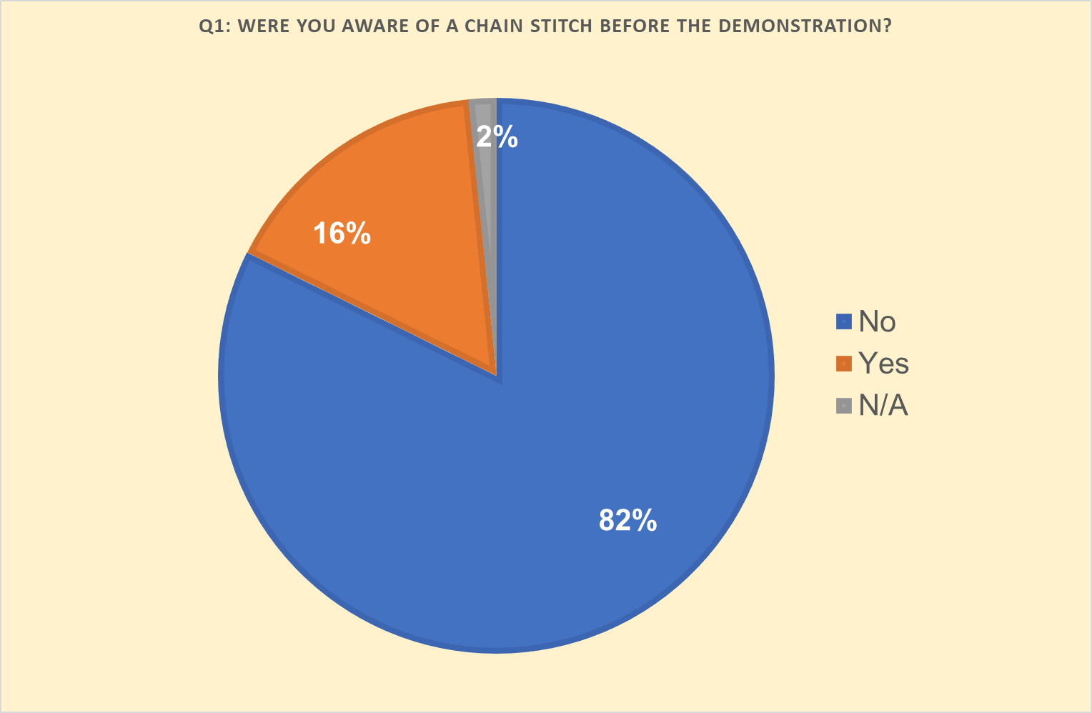
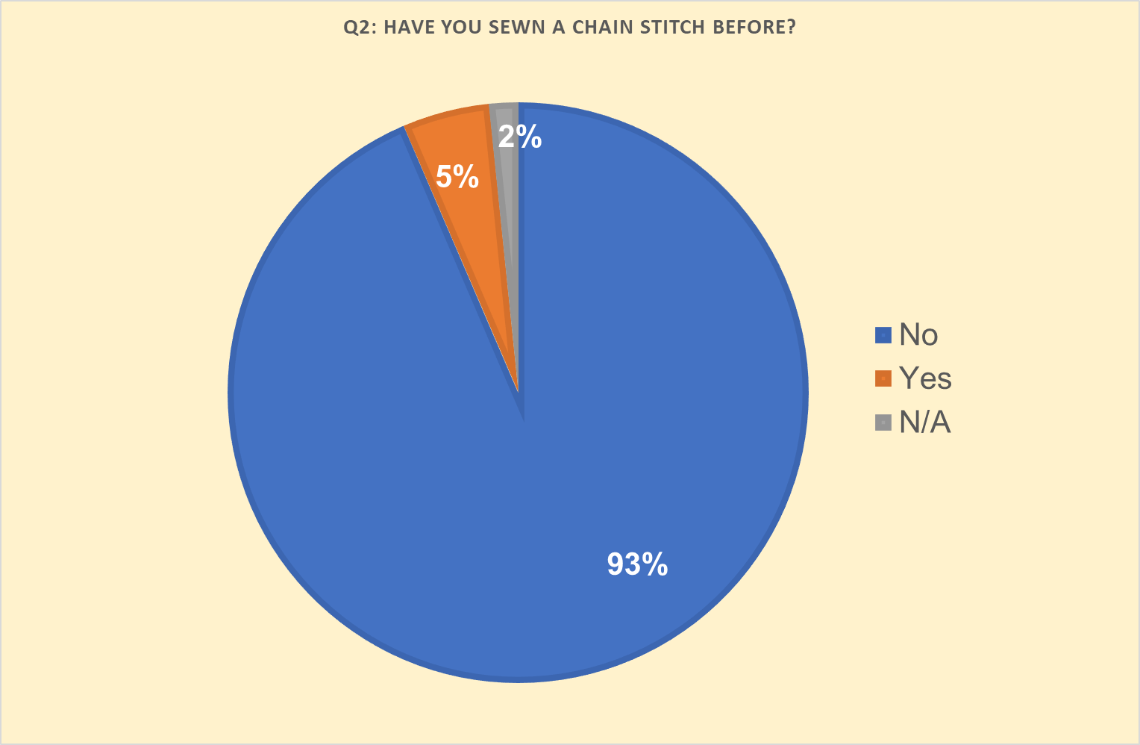
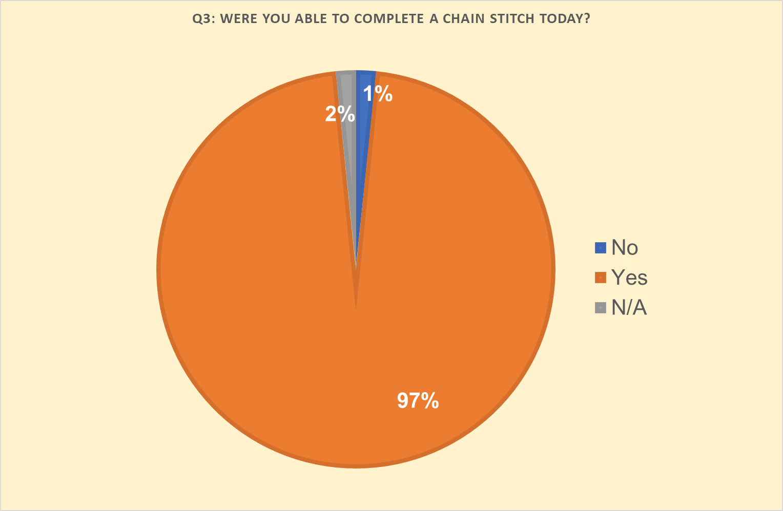
Participant’s Learning Background:
This is to understand the level of technical knowledge prior to the intervention.

Slide 9
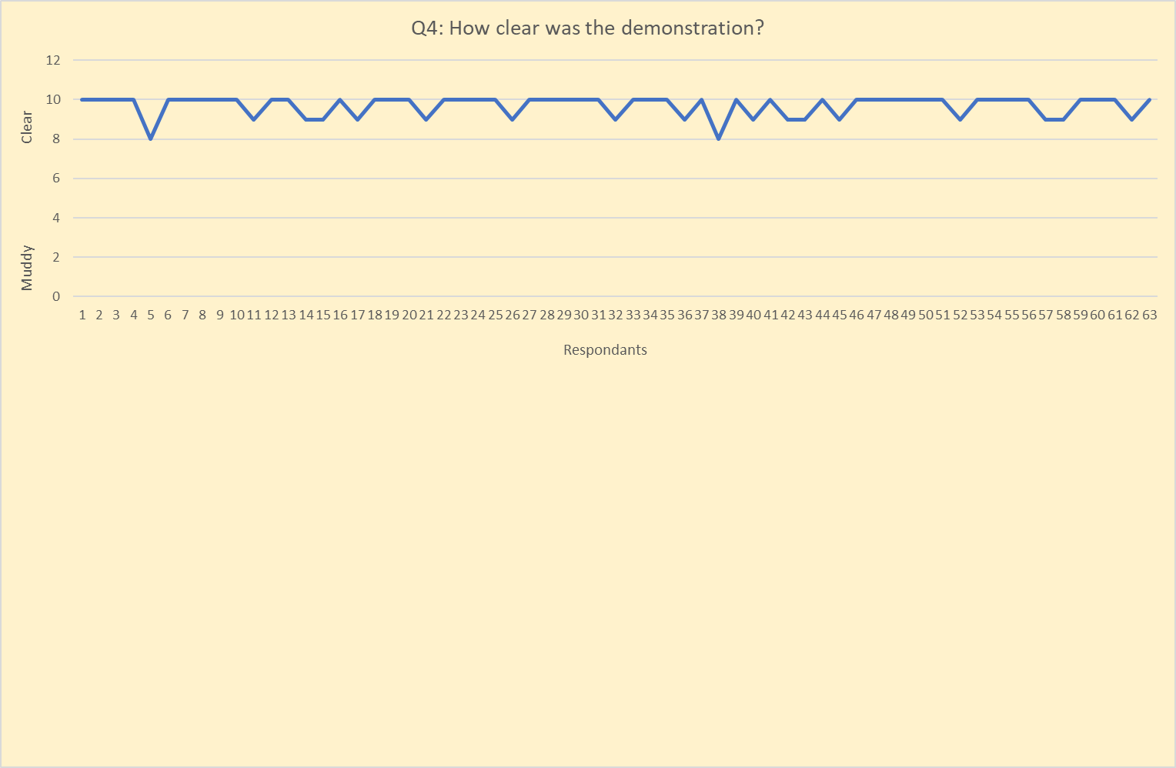
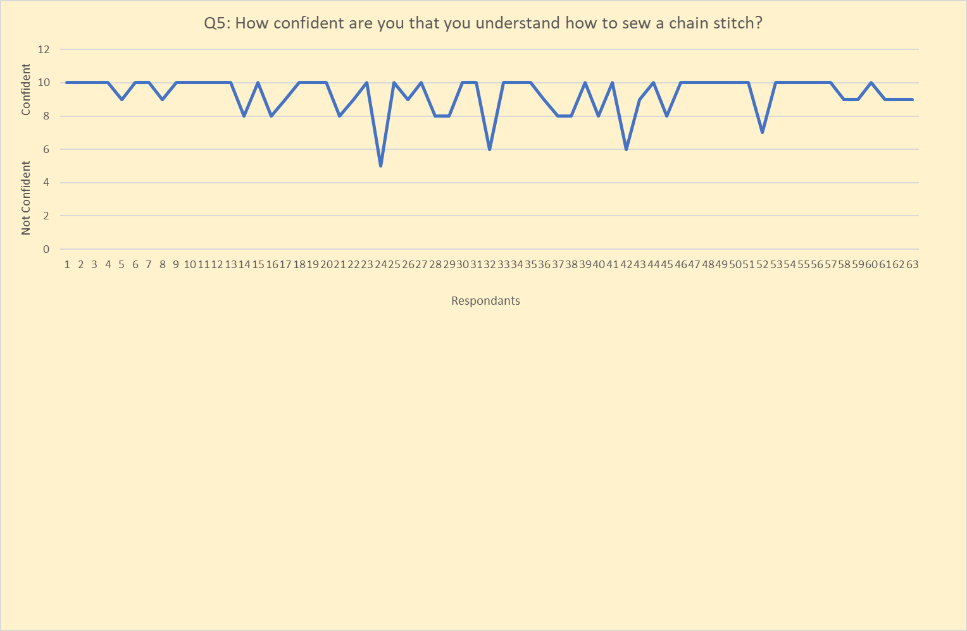
Participant Responses:

Slide 10
Control
PDF
Results of control versus two variations of intervention.

Slide 11
Results for question 6 show lower mean for students who were shown the non-verbal video or illustration before the demonstration with explanations. This meant they reported needing less additional one-to-one help to complete the skill therefore showing better /quicker learning of the skill)
Thematic Analysis of Elicited Comments:
Positives included much mention of clear instruction. I think there is some conscious mirroring of the previous questions; students thinking that the project is about clarity of the teaching. However, there were comments that validate the reasoning for teaching with additional visual supporting material.
"The additional explanation after the video. In person demo. "
“Video then in person increased confidence. Speaking and visuals helped focus.”
“Watching the visual demonstration and talking through each step.”
“Showing me how to do it when I could try it straight away after and the information was fresh in my mind.”
Overwhelmingly the comments were about clarity of instruction, step by step pace and hands on, in person demonstration where students felt comfortable asking questions and repeating until they understood.
“Steps were done in chunks to make it manageable. Clear instruction and a slow demonstration allows for easy understanding. Repetition of steps.”

Slide 12
Difficulties encountered in the micro-teach: Most answered no to this question but the few comments received highlighted issues that I was aware of.
“Maybe was done too fast.”
“When I'm shown too many steps at once.”
“Feels like you have to do it to understand it so maybe a big group would be hard?”
Some of these comments led me to look at the data in different ways, with the addition of some of my field observations about the environment the workshops were taking place in; background noise and disruption, layout of the room. Data fields added- open plan/self-contained room, noisy/calm background.
When answer to question 6 disaggregated into these new categories, means showed more effective learning in:​​
self-contained room - 4.6 ​​
Open Plan - 5.16
Calm environment - 4.87
Chaotic environment- 5.31
Smaller groups – 5
Medium grouops – 5.47

Slide 13
Project Findings- More effective learning can take place if additional visual materials supplied along side clear, well paced, manageably chunked hands on teaching.
Note- In noticing learning, I also noticed my teaching evolved as the workshops continued. Could my results be affected by this.
Also interesting on self-relfexive note, I noticed my own discomfort at having to look at comments that were positive or complimentary
'You will explain the skills many times with patience.'
(Participant 7, 2023)

